Slide 1
Chapter 13
WebApp Design
These slides are designed to accompany Software Engineering: A Practitioner’s Approach, 7/e (McGraw-Hill, 2009) Slides copyright 2009 by Roger Pressman.

Slide 2

Design & WebApps
“There are essentially two basic approaches to design: the artistic ideal of expressing yourself and the engineering ideal of solving a problem for a customer.”
These slides are designed to accompany Software Engineering: A Practitioner’s Approach, 7/e (McGraw-Hill, 2009) Slides copyright 2009 by Roger Pressman.

Slide 3
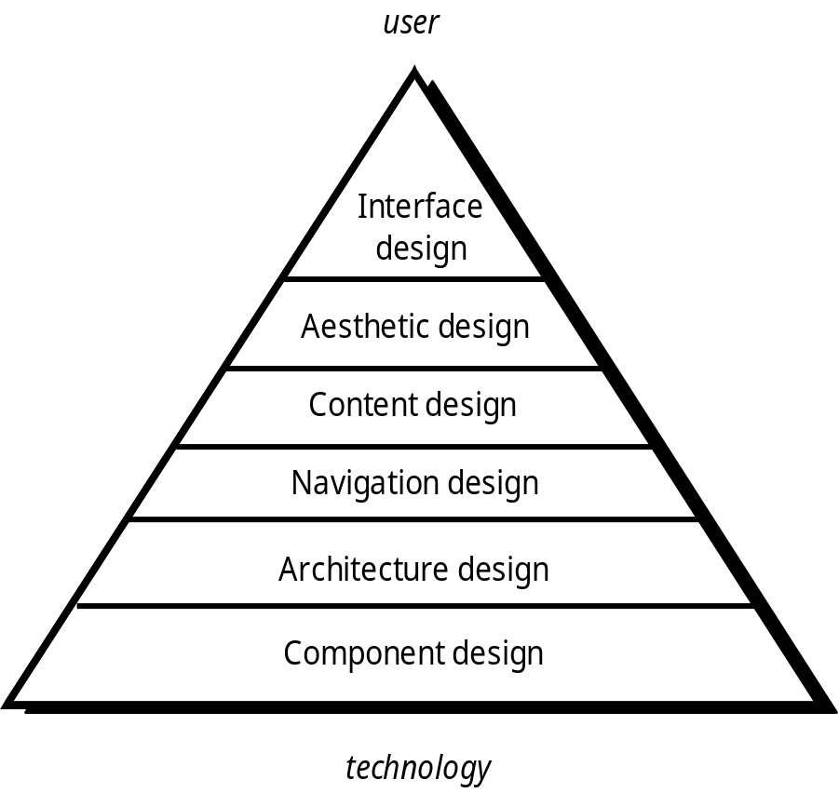
WebE Design Pyramid
These slides are designed to accompany Software Engineering: A Practitioner’s Approach, 7/e (McGraw-Hill, 2009) Slides copyright 2009 by Roger Pressman.

Slide 4
Content Design
Develops a design representation for content objects
  For WebApps, a content object is more closely aligned with a data object for conventional software
Represents the mechanisms required to instantiate their relationships to one another.
  similar to the relationship between analysis classes and design components
A content object has attributes that include content-specific information and implementation-specific attributes that are specified as part of design
These slides are designed to accompany Software Engineering: A Practitioner’s Approach, 7/e (McGraw-Hill, 2009) Slides copyright 2009 by Roger Pressman.

Slide 5
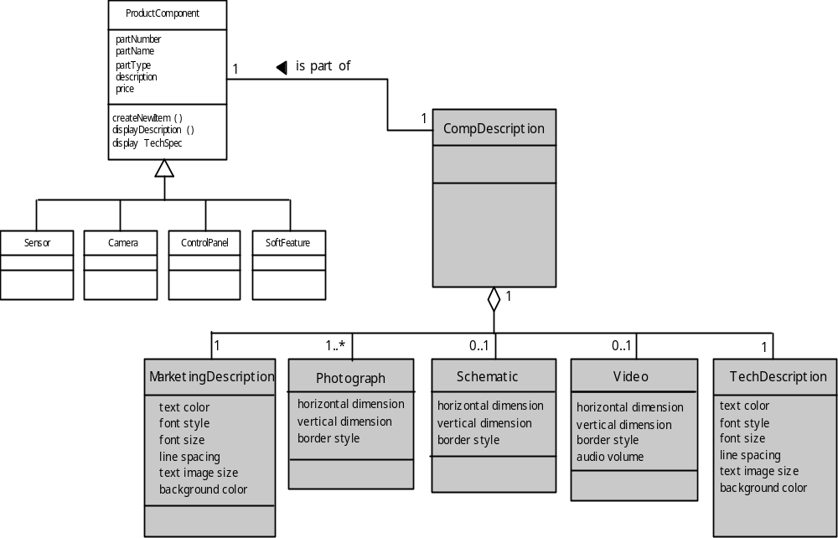
Design of Content Objects
These slides are designed to accompany Software Engineering: A Practitioner’s Approach, 7/e (McGraw-Hill, 2009) Slides copyright 2009 by Roger Pressman.

Slide 6
Architecture Design
Content architecture focuses on the manner in which content objects (or composite objects such as Web pages) are structured for presentation and navigation.
  The term information architecture is used for better organization, labeling, navigation, and searching of content objects.
WebApp architecture addresses the application structure to manage user interaction, handle internal processing tasks, effect of navigation, and presentation of content.
Architecture design is conducted in parallel with interface design, aesthetic design and content design.
These slides are designed to accompany Software Engineering: A Practitioner’s Approach, 7/e (McGraw-Hill, 2009) Slides copyright 2009 by Roger Pressman.

Slide 7
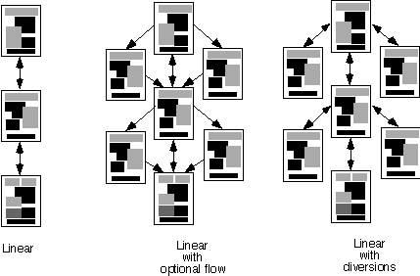
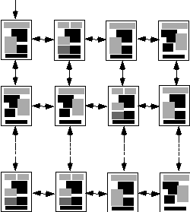
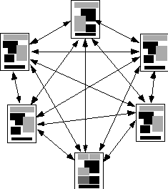
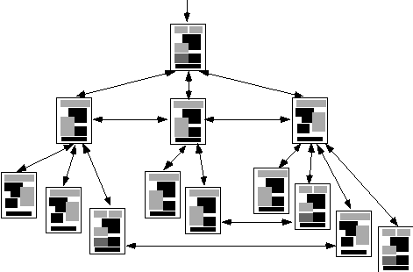
Content Architecture
Linear
structure
grid
Grid
structure
network
Network
structure
Hierarchical
Hierarchical
structure
These slides are designed to accompany Software Engineering: A Practitioner’s Approach, 7/e (McGraw-Hill, 2009) Slides copyright 2009 by Roger Pressman.

Slide 8
What type of content architectures are commonly encountered ?
Linear structure : sequence of interaction is common
(ex. Tutorial presentation , product order entry sequence) in case of complex content linear with optional flow or linear with diversions is used.
Grid structure : used when the content can be organized in two-dimension category . (ex. ecommerce site)
Hierarchical structure : most used when flow of control across vertical branches , special case horizontal navigation is also possible using hypertext link
Network or pure web : components pass control virtually to every other component in the system
Composite structure is also possible by combining any of thye structure as and when required

Slide 9
WebApp Architecture
Describes an infrastructure that enables a web-based system to achieve its business objectives.
Three-layer design architecture is preferable
MVC is one of the webapp infrastructure models that decouple the user interface from the webapp functionality and informational content
These slides are designed to accompany Software Engineering: A Practitioner’s Approach, 7/e (McGraw-Hill, 2009) Slides copyright 2009 by Roger Pressman.

Slide 10
MVC Architecture
The model contains all application specific content and processing logic, including
  all content objects
  access to external data/information sources,
  all processing functionality that are application specific
The view contains all interface specific functions and enables
  the presentation of content and processing logic
  access to external data/information sources,
  all processing functionality required by the end-user.
The controller manages access to the model and the view and coordinates the flow of data between them.
These slides are designed to accompany Software Engineering: A Practitioner’s Approach, 7/e (McGraw-Hill, 2009) Slides copyright 2009 by Roger Pressman.

Slide 11
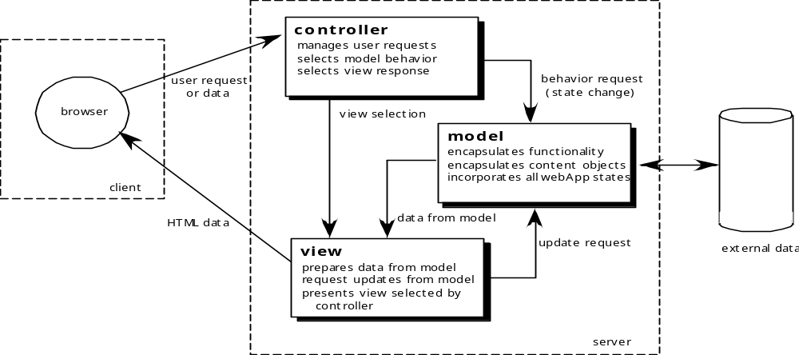
MVC Architecture
Fig shows that user requests or data are handled by the controller The controller also select the view object based on user request, once type of request behavior is determined , request is transmitted to the model to implement functionality or retrieves the content . The Model object can access data stored , data is formatted by view object and transmit from server to client-based browser
These slides are designed to accompany Software Engineering: A Practitioner’s Approach, 7/e (McGraw-Hill, 2009) Slides copyright 2009 by Roger Pressman.

Slide 12
Navigation Design
Begins with a consideration of the user hierarchy and related use-cases
  Each actor may use the WebApp somewhat differently and therefore have different navigation requirements
As each user interacts with the WebApp, it encounters a series of navigation semantic units (NSUs)
  NSU—“a set of information and related navigation structures that collaborate in the fulfillment of a subset of related user requirements”
These slides are designed to accompany Software Engineering: A Practitioner’s Approach, 7/e (McGraw-Hill, 2009) Slides copyright 2009 by Roger Pressman.

Slide 13
Navigation Semantic Units
Navigation semantic unit
  Ways of navigation (WoN)—represents the best navigation way or path for users with certain profiles to achieve their desired goal or sub-goal. Composed of …
    Navigation nodes (NN) connected by Navigation links
link₁₂
NN₂
link₂₄
NN₁
NN₄
NSU
link₁₃
NN₃
link₃₄
These slides are designed to accompany Software Engineering: A Practitioner’s Approach, 7/e (McGraw-Hill, 2009) Slides copyright 2009 by Roger Pressman.

Slide 14
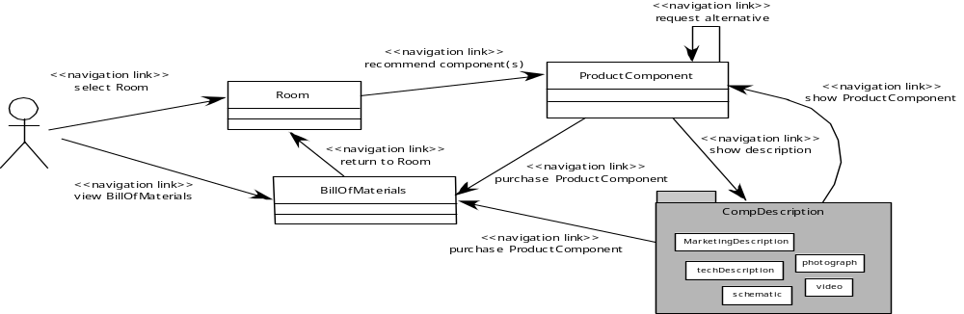
Creating an NSU
Fig. shows a Way Of Navigation for safehomeAssured.com
Navigation nodes based on select safe home components use case
These slides are designed to accompany Software Engineering: A Practitioner’s Approach, 7/e (McGraw-Hill, 2009) Slides copyright 2009 by Roger Pressman.

Slide 15
Navigation Syntax
Individual navigation link—text-based links, icons, buttons and switches, and graphical metaphors..
Horizontal navigation bar—lists major content or functional categories in a bar containing appropriate links.
Vertical navigation column
  lists major content or functional categories
  lists virtually all major content objects within the WebApp.
Tabs—a metaphor that is nothing more than a variation of the navigation bar or column, representing content or functional categories as tab sheets that are selected when a link is required.
Site maps—provide an all-inclusive tab of contents for navigation to all content objects and functionality contained within the WebApp.
These slides are designed to accompany Software Engineering: A Practitioner’s Approach, 7/e (McGraw-Hill, 2009) Slides copyright 2009 by Roger Pressman.

Slide 16
Component-Level Design
WebApp components implement the following functionality
  perform localized processing to generate content and navigation capability in a dynamic fashion
  provide computation or data processing capability that are appropriate for the WebApp’s business domain
  provide sophisticated database query and access
  establish data interfaces with external corporate systems.
These slides are designed to accompany Software Engineering: A Practitioner’s Approach, 7/e (McGraw-Hill, 2009) Slides copyright 2009 by Roger Pressman.

Slide 17
Exercise
Explain in brief design pyramid for WebApp.
Explain in detail content design of WebApp
Explain type of content Architecture of the WebApp with figure
Explain MVC Architecture with figure
Explain Navigation Design and Navigation Syntax in brief.
These slides are designed to accompany Software Engineering: A Practitioner’s Approach, 7/e (McGraw-Hill, 2009) Slides copyright 2009 by Roger Pressman.

